Slide 1
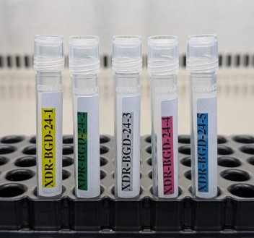
mWRD EQA -KEY COMPONENTS
(GeneXpert & Truenat)
10-12-2024

Slide 2
Contents
Key components of mWRD Quality Assurance programme
Contents of package to the sites
EQA implementation cycle
Summary

Slide 3
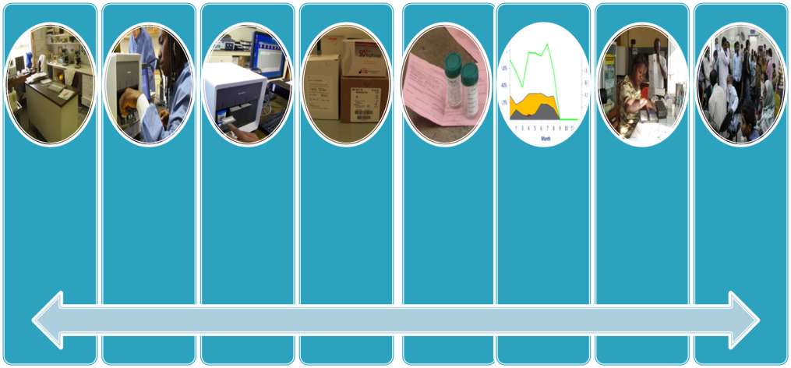
Key components of mWRD quality assurance program
Environment
- Safe and functional
- Temperature control
Personnel
- Trained and competent staff
- Test user is documented
- Current SOPs readily available
Equipment
- Maintained and serviced
Supplies
- Uninterrupted supplies
- Appropriate transport and storage conditions
Specimens
- Good quality
- unique ID
- Completed TRF
Internal quality monitoring
- Test working properly
External
Quality Assessment (EQA)
- Testing site‘s work checked by another site
Accurate and timely reporting
- Turnaround time
Results review
Accurate, reliable and timely results

Slide 4
What is Quality Assurance
Quality assurance (QA) in laboratories incorporates all the factors that may influence the generation of reliable results.
It comprises three key components.
Internal quality control (IQC)
External quality assessment (EQA)
Quality improvement (QI)

Slide 5
Components of Quality assurance
Internal quality control (IQC) It’s a systematic internal monitoring of working practices, technical procedures, equipment and materials. It is inbuild in GX and Truenat.
External quality assessment (EQA): A process to assess laboratory performance (Pre analytical, Analytical & Post Analytical). This component is necessary to ensure comparability of results among laboratories.
Quality improvement (QI): Involves continued monitoring, identifying the gaps, followed by remedial action including retraining when needed, to prevent recurrence of problems.

Slide 6
Why EQA?
EQA is also termed as proficiency testing and method to assess laboratory performance(Pre analytical, analytical & Post analytical)
EQA strongly contributes to continuous quality improvement of laboratory performance
Participating laboratories benefit because external quality assessment:
serves as an early warning system,
identifies systematic problems,
provides objective evidence of laboratory quality,
serves as an indicator for focusing improvement efforts,
identifies training needs,
provides a source for continuing education,
provides a source of materials for practice

Slide 7
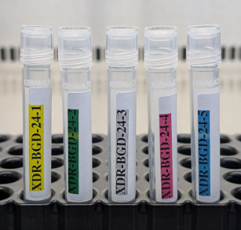
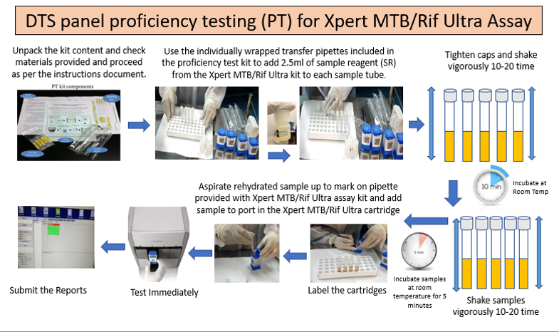
Components of mWRD EQA package
5 Panel Tubes
5 Pasture Pipettes
Processing SOP

Slide 8
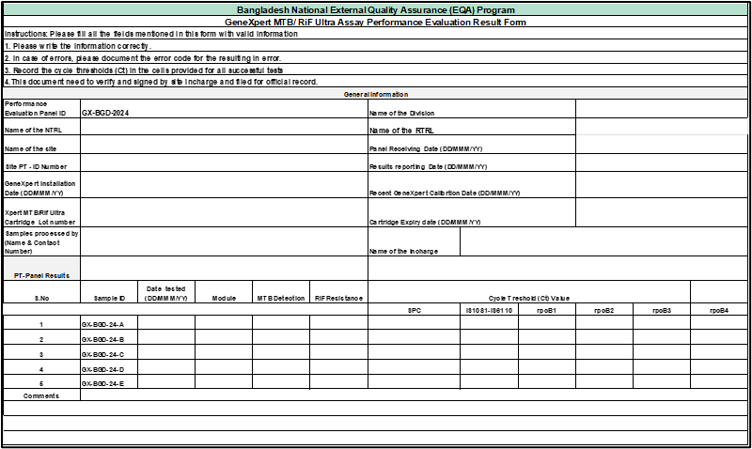
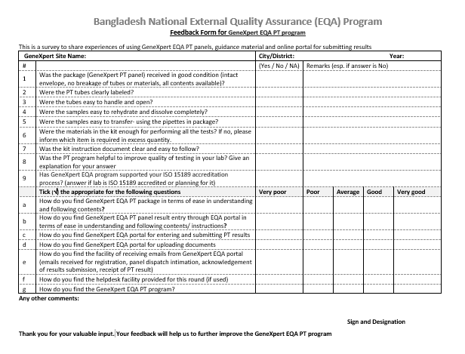
Components of mWRD EQA package
Result Reporting Form
Feedback Form

Slide 9
EQA implementation cycle
Manufacturing and
Panel Validation and verification
Packaging and shipment
Feedback report to the sites & respective division & RTRL & NTP
Collection, Compilation and data analysis
Post EQA visits and action taken report submission to NTP and Divisions
Testing panel & Reporting
Collection of site contact information (address/phone) & Registration in EQA portal
mWRD EQA orientation & Cascade trainings

Slide 10
Summary
Quality assurance is integral and key component of lab activities and is not additional activity
All quality assurance activities must be documented
Feedback to testing sites and implementing corrective and preventive measures are the most critical aspects of any quality assurance programme
Quality assurance is essential to all the GeneXpert placed in a TB control programme.

Slide 11
ধন্যবাদ

